Slide 1
Research Design
Is the arrangement of conditions for collection and analysis of data in a manner that aims to combine relevance to the research purpose with economy in procedure.
The research design is the conceptual structure within which research is conducted; it constitutes the blueprint for the collection, measurement and analysis of data.
As such the design includes an outline of what the researcher will do from writing the hypothesis and its operational implications to
the final analysis of data.

Slide 2
The overall research design maybe slipted into the following parts:
(a) the sampling design which deals with the method of selecting items to be observed for the given study;
(b) the observational design which relates to the conditions under which the observations are to be made;
(c) the statistical design which concerns with the question of how many items are to be observed and how the information and data gathered are to be analysed.
(d) the operational design which deals with the techniques by which the procedures specified in the sampling, statistical and observational designs can be carried out.

Slide 3
The important features of a research design
(i) It is a plan that specifies the sources and types of information relevant to the research problem.
(ii) It is a strategy specifying which approach will be used for gathering and analysing the data.
(iii) It also includes the time and cost budgets since most studies are done under these two constraints
In brief, research design must, at least, contain—
(a) a clear statement of the research problem;
(b) procedures and techniques to be used for gathering information; (c) the population to be studied;
(d) methods to be used in processing and analysing data.

Slide 4
NEED FOR RESEARCH DESIGN
Research design is needed because it facilitates the smooth sailing of the various research operations, thereby making research as efficient as possible yielding maximal information with minimal expenditure of effort, time and money.
Just as for better, economical and attractive construction of a house, we need a blueprint (or what is commonly called the map of the house) well thought out and prepared by an expert architect.
similarly we need a research design or a plan in advance of data collection and analysis for our research project.

Slide 5
DIFFERENT RESEARCH DESIGNS
Different research designs can be conveniently categorized as:
Research design in case of exploratory research studies;
Research design in case of descriptive and diagnostic research studies, a
Research design in case of hypothesis-testing research studies.

Slide 6
Research design in case of exploratory research studies: Exploratory research studies are also termed as formulative research studies.
The main purpose of such studies is that of formulating a problem for more precise investigation or of developing the working hypotheses from an operational point of view.
2. Research design in case of descriptive and diagnostic research studies: Descriptive research studies are those studies which are concerned with describing the characteristics of a particular individual, or of a group, whereas diagnostic research studies determine the frequency with which something occurs or its association with something else.
The studies concerning whether certain variables are associated are examples of diagnostic research studies.

Slide 7
3. Research design in case of hypothesis-testing research studies: Hypothesis-testing research studies (generally known as experimental studies) are those where the researcher tests the hypotheses of causal relationships between variables.

Slide 8


Slide 9
Introduction
The task of data collection begins after a research problem has been defined and research design/plan written out.
While deciding about the method of data collection to be used for the study, the researcher should keep in mind two types of data ;primary and secondary.
The researcher would have to decide which sort of data he would be using (thus collecting) for his study and accordingly he will have to select one or the other method of data collection.
The methods of collecting primary and secondary data differ since primary data are to be originally collected, while in case of secondary data the nature of data collection work is merely that of compilation.

Slide 10
Data collection
Data collection is for the purposes of compliance with ethics and data storage policies.
‘Data' means 'original information which is collected, stored, accessed, used or disposed of during the course of the research, and the final report of the research findings'.
Data Collection is a process to find out the answer for the research problem.

Slide 11
Types of data
There are two types of data - primary and secondary
The primary data are collected fresh and for the first time from the field.
If the interaction or observation or sometimes both methods are not framed properly, there will be many loophole in the collected primary data.

Slide 12
Primary data is collected in the course of doing experiments in an experimental research but in case of doing research of the descriptive type and perform surveys, whether sample surveys or census surveys, then primary data can be obtained either through observation or through direct communication with respondents in one form or another or through personal interviews.

Slide 13
Methods of collecting primary data
There are several methods of collecting primary data, particularly in surveys and descriptive researches.
Important ones are: (i) observation method, (ii) interview method, (iii) through questionnaires, (iv) through schedules,
Other methods which include (a) warranty cards; (b) distributor audits; (c) pantry audits; (d) consumer panels; (e) using mechanical devices; (f) through projective techniques; (g) depth interviews, and (h) content analysis. We briefly take up each method separately.

Slide 14
Primary Data Collection Method
a) Case Study method
b) Observational method
c) Interview method
d) Questionnaire method
e) Schedule method

Slide 15
The case study method
The case study method is a very popular method in qualitative analysis.
It involves a careful and complete observation of social unit.
Social Unit- a person or a family, or an institution or a cultural group or the entire community.
It is in depth study of relevant incidents related to the selected topic of research.
E.g.- A lawyer refers many relevant case histories similar to the case of his client and tries to influence the judgment in favour of his client, likewise the researcher also put forward many previous instances to establish the answer of his research question.

Slide 16
Characteristics of case study method
Researcher take one single social unit or more of such units for his study purpose.
The selected unit is studied intensively i.e., it is studied in minute /tiny details. The study extends over a long period of time to ascertain the natural history of the unit so as to obtain enough information for drawing correct conclusions.
An effort is made to know the mutual inter-relationship of causal factors.
The behaviour pattern of the concerning unit is studied directly and not by an indirect and abstract approach.

Slide 17
Interview method
Collecting data involves presentation of oral verbal stimuli and reply in terms of oral verbal responses.
Two types of taking interviews
Personal interview
Telephonic interview
Personal interview-This method requires a person known as the interviewer asking questions generally in a face to face contact to the other person or persons who are considered as interviewee.
Telephonic interview-This method of collecting information consist in contacting respondents via telephone.

Slide 18
Merits of the Interview method
More information and in greater depth can be obtained.
Interviewer by his own skill can overcome the resistance, if any, of the respondents.
There is greater flexibility under this method as the opportunity to restructure questions is always there, specially in case of unstructured interviews.
Personal information can as well be obtained easily under this method.
Samples can be controlled more effectively as there arises no difficulty of the missing returns; non-response generally remains very low.
The interviewer can usually control which person(s) will answer the questions. This is not possible in mailed questionnaire approach.

Slide 19
Weaknesses of Interview method
It is a very expensive method, specially when large and widely spread geographical sample is taken.
There is possibility of the bias of interviewer as well as that of the respondent; there also remains the headache of supervision and control of interviewers.
Certain types of respondents such as important officials or executives or people in high income groups may not be easily approachable under this method and to that extent the data may prove inadequate.
Relatively more-time-consuming, specially when the sample is large and recall upon the respondents are necessary.
The presence of the interviewer on the spot may over-stimulate the respondent, sometimes even to the extent that he may give imaginary information just to make the interview interesting.
The organization is required in selecting, training and supervision in the field-staff is more complex with difficult problems.
Interviewing at times may also introduce systematic errors.

Slide 20
Observation method
The information is sought by way of investigator’s own direct observation without asking from the respondent.
i.e in a study relating to consumer behaviour, the investigator instead of asking the brand of wrist watch used by the respondent, he may himself look at the watch.
The main advantage of this method is that subjective bias is eliminated, if observation is done accurately.
The information obtained under this method relates to what is currently happening; it is not complicated by either the past behaviour or future intentions or attitudes.
This method is independent of respondents’ willingness to respond and as such is relatively less demanding of active cooperation on the part of
respondents as happens to be the case in the interview or the questionnaire method.

Slide 21
Limitations of Observation method
It is an expensive method.
The information provided by this method is very limited.
Sometimes unforeseen factors may interfere with the observational task.
At times, the fact that some people are rarely accessible to direct observation creates obstacle for this method to collect data effectively

Slide 22
Types Observation
Structured observation.
is characterised by a careful definition of the units to be observed, the style of recording the observed information, standardised conditions of observation and the selection of pertinent data of observation.
Unstructured observation.
when observation is to take place without these characteristics to be thought of in advance.
Participant observation.
This distinction depends upon the observer’s sharing or not sharing
the life of the group he is observing. If the observer observes by making himself, more or less, a member of the group he is observing so that he can experience what the members of the group experience.
Non-participant observation.
When the observer observes as a detached agent without any attempt on his part to experience through participation what others feel

Slide 23
Questionnaire method
A questionnaire consist of a number of questions printed or typed in a definite order on a form or set of forms.
The questionnaire is mailed or posted or sent personally to the respondents.
The respondents are expected to read and understand the questions and write down the reply in the given space meant
for the purpose in the questionnaire itself.
The respondents have to answer the questions on their own.
The method of collecting data by mailing the questionnaires to respondents is most extensively employed in various economic and business surveys.

Slide 24
The merits of Questionnaire method
There is low cost even when the universe is large and is widely spread geographically.
It is free from the bias of the interviewer; answers are in respondents’ own words.
Respondents have adequate time to give well thought out answers.
Respondents, who are not easily approachable, can also be reached conveniently.
Large samples can be made use of and thus the results can be made more dependable and reliable.

Slide 25
The demerits of Questionnaire method
Low rate of return of the properly filled in questionnaires
It can be used only when respondents are educated and cooperating.
The control over questionnaire may be lost once it is sent.
There is inbuilt inflexibility because of the difficulty of amending the approach once questionnaires have been despatched.
There is also the possibility of ambiguous replies or omission of replies altogether to certain questions; interpretation of omissions is difficult.
It is difficult to know whether willing respondents are truly representative.
This method is likely to be the slowest of all.

Slide 26
Schedules method
This method is very similar to questionnaire.
But the difference which lies in the fact that schedules are being filled in by the researcher after getting the reply from the respondents.
This method is very useful in extensive enquiries and can lead to fairly reliable results.
Census is done especially through this method.

Slide 27
Some other methods of data collection
Warranty card.
Distribution or store audits.
Pantry audits.
Consumer panels.
Use of mechanical devices.
Projective techniques.
Depth interviews.
Content analysis.

Slide 28
The secondary data are collected from secondary sources.
Secondary data means data that are already available i.e., they refer to the data which have already been collected and analyzed by someone else.
The usefulness and relevancy of secondary data depends upon
1) Reliability of data
2) Suitability of data
3) Adequacy of data

Slide 29
Secondary data may either be published data or unpublished data.
Usually published data are available in;
(a) various publications of the central, state are local governments;
(b) various publications of foreign governments or of international bodies and their subsidiary organizations;
(c) technical and trade journals;
(d) books, magazines and newspapers;
(e) reports and publications of various associations connected with business and industry, banks, stock exchanges, etc.;
(f) reports prepared by research scholars, universities, economists, etc. in different fields;
(g) public records and statistics, historical documents, and other sources of published information.

Slide 30
The researcher, before using secondary data, must see that they possess following characteristics
1. Reliability of data: The reliability can be tested by finding out such things about the said data:
(a) Who collected the data?
(b) What were the sources of data?
(c) Were they collected by using proper methods
(d) At what time were they collected?
(e) Was there any bias of the compiler?
(t) What level of accuracy was desired? Was it achieved ?

Slide 31
2. Suitability of data: The data that are suitable for one enquiry may not necessarily be found suitable in another enquiry. Hence, if the available data are found to be unsuitable, they should not be used by the researcher.
In this context, the researcher must very carefully scrutinize the definition of various terms and units of collection used at the time of collecting the data from the primary source originally.
Similarly, the object, scope and nature of the original enquiry must also be studied.
If the researcher finds differences in these, the data will remain unsuitable for the present enquiry and should not be used.

Slide 32
3. Adequacy of data:
If the level of accuracy achieved in data is found inadequate for the purpose of the present enquiry, they will be considered as inadequate and should not be used by the researcher.
The data will also be considered inadequate, if they are related to an area which may be either narrower or wider than the area of the present enquiry.

Slide 33
There are broadly two approaches which are followed in data collection process
✓ Experiments
✓ Surveys
An experiment refers to investigation. The factor or variable under the test and its effect are measured.
Survey refers to the method of securing information concerning a phenomena under the study from all or a selected number of respondents of the concerned universe.

Slide 34
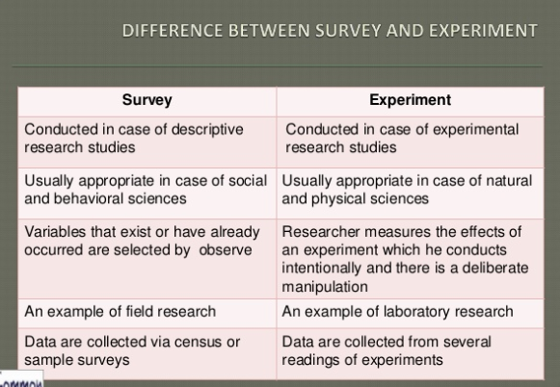

Slide 35
Criteria for selection of data collection method
Nature, scope and objective of research: The selected data collection method should always maintain a balance among nature, scope and objectives of the study.
Budget: Availability of funds for the research project determines to a large extent which the method would be suitable for the collection of data.
Time: Prefixed time frame for the research project has also to be taken into account in deciding a particular method of data collection.
Sufficient knowledge: Proper procedure and required sufficient knowledge helps to select the perfect data collection method..

Slide 36


Slide 37
Introduction to Data Analysis
Once data has been collected, it has to be processed and analyzed in accordance with the outline laid down for the purpose at the time of developing the research plan.
This is essential for a scientific study and for ensuring that we have all relevant data for making intended comparisons and analysis.
processing implies editing, coding, classification and tabulation of collected data so that they are responsive to analysis.
It involves actions and methods performed on data that help describe facts, detect patterns, develop explanations and test hypotheses.
This includes data quality assurance, statistical data analysis, modeling, and interpretation of results.

Slide 38
Data Analysis
Data Analysis, is the process of inspecting, cleaning ,transforming and modeling data with the objective of discovering useful information, arriving at conclusions and supporting decision making process.
Analysis refers to the computation of certain measures along with searching for patterns of relationship that exist among data-groups
Analysis of data in a general way involves a number of closely related operations which are performed with the purpose of summarizing the collected data and organizing these in such a manner that they answer the research question(s).
The purpose Data Analysis
To answer the research questions and to help determine the trends and relationships among the variables.

Slide 39
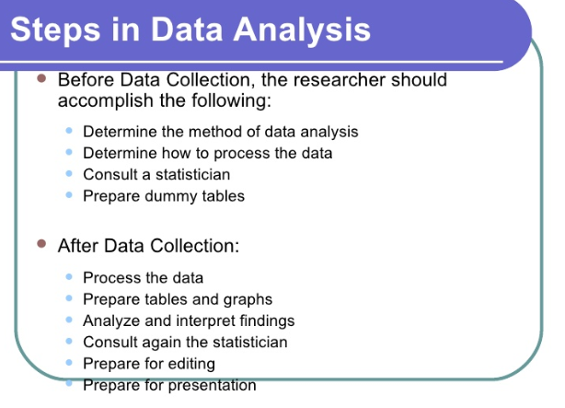

Slide 40
PROCESSING OPERATIONS
Basic steps in preliminary data analysis
Editing
Coding
Classification
Tabulating

Slide 41
PROCESSING OPERATIONS
Editing: Editing of data is a process of examining the raw data collected (specially in surveys) to detect errors and omissions and to correct these when possible.
Editing involves a careful scrutiny( Inspection) of the completed questionnaires and/or schedules.
Editing is done to assure that the data (is)are accurate, consistent with other facts gathered, uniformly entered, as completed as possible and have been well arranged to facilitate coding and tabulation.

Slide 42
Stages at which editing should be done,
Field editing
This type of editing is necessary in view of the fact that individual writing styles often can be difficult for others to interpret.
This sort of editing should be done as soon as possible after the interview, preferably on the very day or on the next day.
While doing field editing, the investigator must restrain himself and must not correct errors of omission by simply guessing what the informant would have said if the question had been asked.

Slide 43
Central editing should take place when all forms or schedules have been completed and returned to the office.
This type of editing implies that all forms should get a thorough editing by a single editor in a small study and by a team of editors in case of a large inquiry.
Editor(s) may correct the obvious errors such as an entry in the wrong place, entry recorded in months when it should have been recorded in weeks, etc.
In case of inappropriate or missing replies, the editor can sometimes determine the proper answer by reviewing the other information in the schedule.

Slide 44
2.Coding –
Is the process of assigning numerals or other symbols to answers so that responses can be put into a limited number of categories or classes.
Transforming raw data into symbols (usually numbers) for tabulating, counting, and analyzing
They must also possess the characteristic of
Completely exhaustive(i.e., there must be a class for every data item)
Mutually exclusive -means that a specific answer can be placed in one and only one cell in a given category set

Slide 45
Coding is necessary for efficient analysis and through it the several replies may be reduced to a small number of classes which contain the critical information required for analysis.
Coding decisions should usually be taken at the designing stage of the questionnaire.
This makes it possible to precode the questionnaire choices which in turn is helpful for computer tabulation.

Slide 46
3.Classification–
Most research studies result in a large volume of raw data which must be reduced into homogeneous groups if we are to get meaningful relationships.
This fact necessitates classification of data which happens to be the process of arranging data in groups or classes on the basis of common characteristics.
Data having a common characteristic are placed in one class and in this way the entire data get divided into a number of groups or classes.

Slide 47
The Two Types of Classification
1.Classification according to attributes:
Data are classified on the basis of common characteristics which can either be descriptive (such as literacy, gender, honesty, etc.) or numerical (such as weight, height, income, etc.).
Descriptive characteristics refer to qualitative phenomenon which cannot be measured quantitatively; only their presence or absence in an individual item can be noticed.
Data obtained this way on the basis of certain attributes are known as statistics of attributes and their classification is said to be
classification according to attributes

Slide 48
2.Classification according to class-intervals:
Unlike descriptive characteristics, the numerical characteristics refer to quantitative phenomenon which can be measured through some statistical units.
Data relating to income, production, age, weight, etc. come under this category. Such data are known as statistics of variables and are classified on the basis of class intervals.
For instance, persons whose incomes, say, are within Kshs 20,000 to Kshs 40,000 can form one group, those whose incomes are within Kshs 40,001 to Kshs 60,000 can form another group and so on.
In this way the entire data may be divided into a number of groups or classes or what are usually called, ‘class-intervals.’

Slide 49
Each group of class-interval, has an upper limit as well as a lower limit which are known as class limits.
The difference between the two class limits is known as class magnitude.
We may have classes with equal class magnitudes or with unequal class magnitudes.
The number of items which fall in a given class is known as the frequency of the given class.
All the classes or groups, with their respective frequencies taken together and put in the form of a table, are described as group frequency distribution or simply frequency distribution.

Slide 50
Classification according to class intervals usually involves the following three main problems:
(i) How may classes should be there? What should be their magnitudes?
The decision about this calls for skill and experience of the researcher.
However, the objective should be to display the data in such a way as to make it meaningful for the analyst.
Typically, we may have 5 to 15 classes.
second part of the question, we can say that, to the extent possible, class-intervals should be of equal magnitudes, but in some cases unequal magnitudes may result in better classification

Slide 51
(ii) How to choose class limits?
While choosing class limits, the researcher must take into consideration the measure that the mid-point (generally worked out first by taking the sum of the upper limit and lower limit of a class and then divide this sum by 2) of a class-interval and the actual average of items of that class interval should remain as close to each other as possible.

Slide 52
Class limits may generally be stated in any of the following forms:
Exclusive type class intervals: They are usually stated as follows:
10–20
20–30
30–40
40–50
The above intervals should be read as under:
10 and under 20
20 and under 30
30 and under 40
40 and under 50

Slide 53
Under the exclusive type class intervals, the items whose values are equal to the upper limit of a class are grouped in the next higher class.
For example, an item whose value is exactly 30 would be put in 30–40 class interval and not in 20–30 class interval.
In simple words, we can say that under exclusive type class intervals, the upper limit of a class interval is excluded and items with values less than the upper limit (but not less than the lower limit) are put in the given class interval.

Slide 54
Inclusive type class intervals: They are usually stated as follows:
11–20
21–30
31–40
41–50
In inclusive type class intervals the upper limit of a class interval is also included in the concerning class interval. Thus, an item whose value is 20 will be put in 11–20 class interval.
The stated upper limit of the class interval 11–20 is 20 but the real limit is 20.99999 and as such 11–20 class interval really means 11 and under 21.

Slide 55
(iii) How to determine the frequency of each class?
This can be done either by tally sheets or by mechanical aids.
Under the technique of tally sheet, the class-groups are written on a sheet of paper (commonly known as the tally sheet) and for each item a stroke (usually a small vertical line) is marked against the class group in which it falls.
The general practice is that after every four small vertical lines in a class group, the fifth line for the item falling in the same group, is indicated as horizontal line through the said four lines and the resulting flower (IIII) represents five items.
All this facilitates the counting of items in each one of the class groups. An illustrative tally sheet can be shown as under:

Slide 56
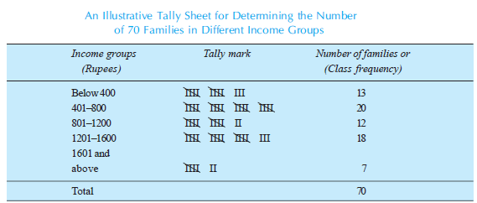

Slide 57
4.Tabulation Of Data –
Is the systematic arrangement of data in column and rows. It is designed to simplify presentation of data for the purpose of analysis and statistical interpretations.
Tabulation is the of process summarizing raw data and displaying the same in compact form (i.e., in the form of statistical tables) for further analysis.
Tabulation is an orderly arrangement of data in columns and rows

Slide 58
Tabulation is essential because of the following reasons.
1. It preserves space and reduces explanatory and descriptive statement to a minimum.
2. It facilitates the process of comparison.
3. It facilitates the summary of items and the detection of errors and omissions.
4. It provides a basis for various statistical computations.

Slide 59
Major Objectives of Data Tabulation
To carry out investigations
To facilitate comparison
To locate omissions and errors in the data
To use space economically
To study the trends
To simplify the complex data
To use it as future references
To draw valid inference / conclusions
To help for further analysis

Slide 60
Differences between Classification and Tabulation
1. First data are classified and presented in tables; classification is the basis for tabulation.
2. Tabulation is a mechanical function of classification because, in tabulation, classified data are placed in row and columns.
3. Classification is a process of statistical analysis while tabulation is a process of presenting data is suitable structure

Slide 61
Importance of Tabulation
Data is divided into various parts and for each part there are totals and sub totals. Therefore, relationship between different parts can be easily known.
Since data are arranged in a table with a title and a number it can be easily identified and used for the required purpose
Tabulation makes the data brief, therefore, it can be easily presented in the form of graphs.
Tabulation presents the numerical figures in attractive form.

Slide 62
Methods of Tabulation
1.Simple tabulation
when the data are tabulated to one characteristic.
Simple tabulation generally results in one-way tables which supply answers to questions about one characteristic of data only.
2.Double tabulation
is when two characteristics of data are tabulated.
For example, frequency or number of male and female employees in the firm owning different brand of mobile phones like Blackberry, Nokia, Iphone, etc.

Slide 63
3.Complex tabulation .
Complex tabulation of data that includes more than two characteristics.
For example, frequency or number of male, female and the total employees owning different brand of mobile phones like Blackberry, Nokia, I phone, etc.
Cross tabulations, is also a sub-type of complex tabulation that includes cross-classifying factors to build a contingency table of counts or frequencies at each combination of factor levels.
A contingency table is a display format used to analyze and record the possible relationship between two or more categorical variables

Slide 64
Frequency
Frequency is basically the number of times a data item occurs in the series. In other words, it deals with how frequent a data item is in the series. For example, if the weight of 5 students in a class is exactly 65 kg, then the frequency of data item 65kg is 5.
Class Frequency
is the number of times the items corresponding to a class interval repeat in the series. In simple words, it is the frequency of a class. For example, if there are 10 students weighing 50-60 kg, then the class frequency for the class 50-60 is 10

Slide 65
Frequency Distribution
A frequency distribution is the organization of raw data in table form, using classes and frequency
The right column contains the list of frequencies, or number of occurrences of each class/group. Intervals are normally of equal size covering the sample observations range.
It is simply a table in which the gathered data are grouped into classes and the number of occurrences, which fall in each class, is recorded.

Slide 66
A frequency distribution can be classified as
a) Series of individual observation
b) Discrete (ungrouped) Frequency Distribution
c) Continuous frequency distribution (grouped frequency distribution)
a)Series of individual observation; is a series where the items are listed once after each observation. For statistical calculations, these observations could be arranged in either ascending or descending order. This is called as array.

Slide 67
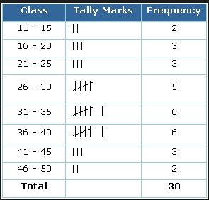

Slide 68
a) Discrete (ungrouped) Frequency Distribution
If the data series are presented in such away that indicating its exact measurement of units, then it is called as discrete frequency distribution.
Discrete variable is one where the variants differ from each other by definite amounts.
Ex:
Assume that a survey has been made to know number of post-graduates in 10 families at random; the resulted raw data could be as follows.
0, 1, 3, 1, 0, 2, 2, 2, 2, 4
This data can be classified into ungrouped frequency distribution.
The number of post-graduates becomes variable (x) for which we can list the frequency of occurrence (f) in a tabular form as follows;

Slide 69
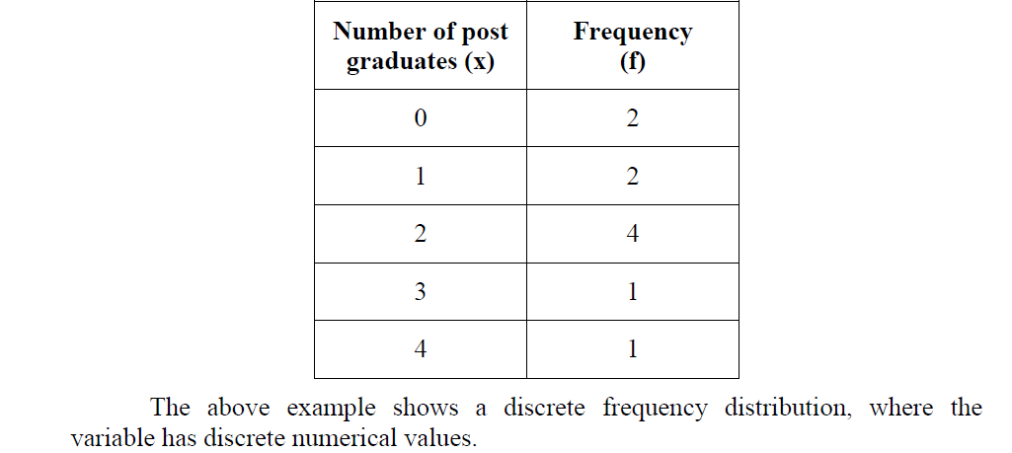

Slide 70
c)Continuous frequency distribution (grouped frequency distribution)
Continuous data series is one where the measurements are only approximated and are expressed in class intervals within certain limits.
In continuous frequency distribution the class interval is theoretically continuous from the starting of the frequency distribution till the end without break.
The variable which can take very intermediate value between the smallest and largest value in the distribution is a continuous frequency distribution.

Slide 71
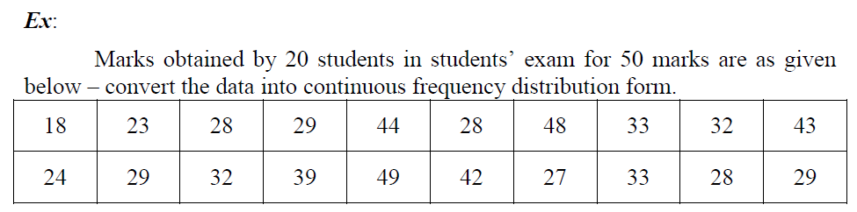

Slide 72
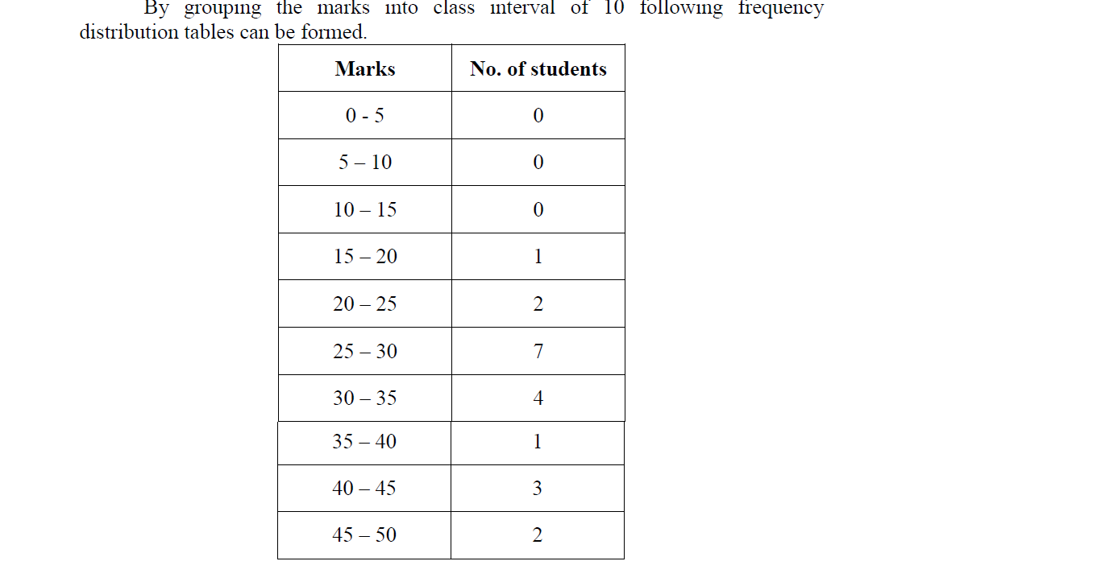

Slide 73
